Slide 1
Welcome To LTI INSURANCE

Slide 2
Created by:
Saransh Gahlot-(TL)
Naman Jain
Shabdita Yadav
Utkarsh Sharma

Slide 3

Best Practices
Use Helper Methods.
Write Test Cases.
Pair Programming
Consistent Indentation
File and Folder Structure
Proper Naming Conventions
Avoid Deep Nesting.
Often Backup and Saving.

Slide 4
Objective
Buy Insurance for Travel/ Vehicle
Claim Insurance
Renew Insurance
Dashboard for Admin –(Status Confirm)
Dashboard For User-(List of Policies)

Slide 5
Core Modules
BUY INSURANCE
CLAIM INSURANCE
RENEW INSURANCE
DASHBOARD

Slide 6
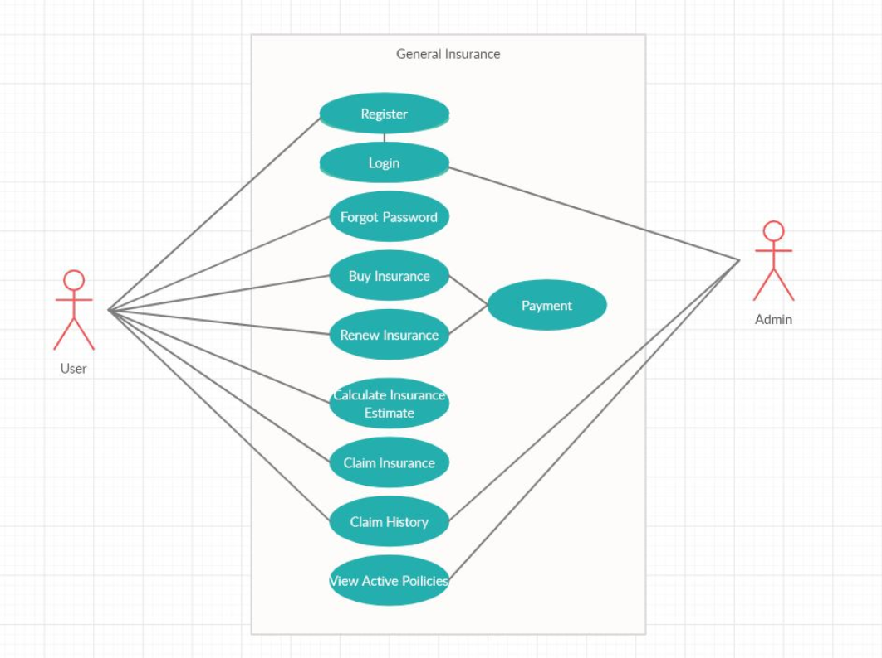
USE CASE

Slide 7
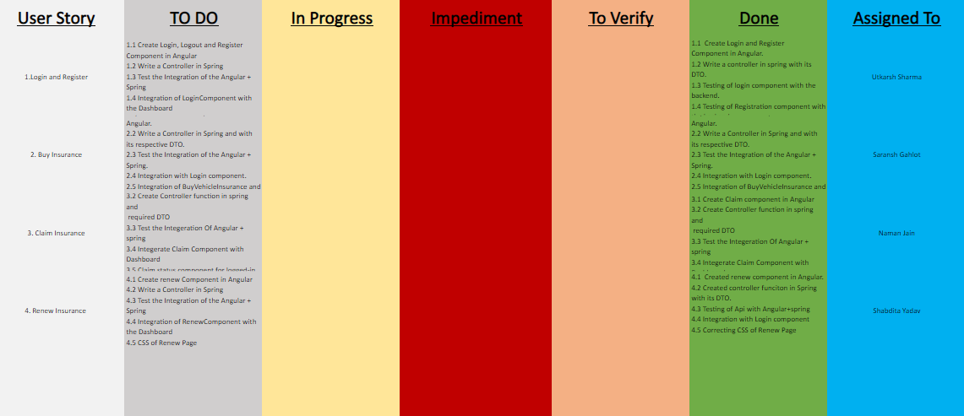
Sprint-1

Slide 8
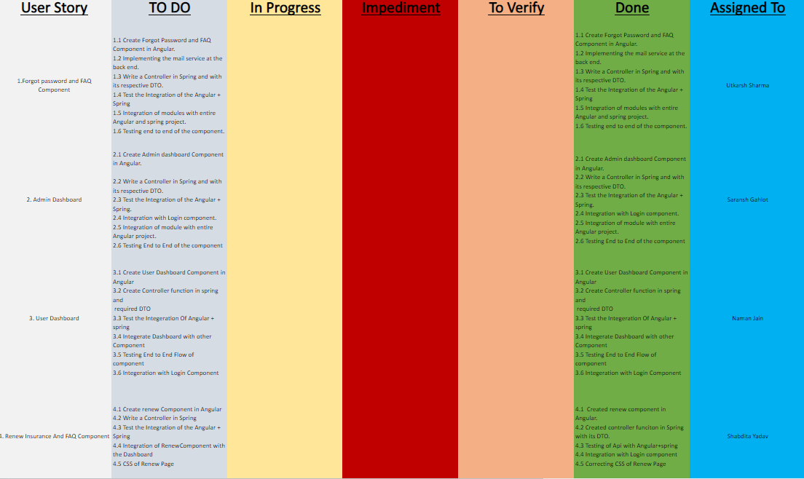
Sprint-2

Slide 9
THANK YOU

